Slide 1

Practical Python For Modelers
J.D. Landgrebe
Data Delve LLC
version April 13, 2023

Slide 2
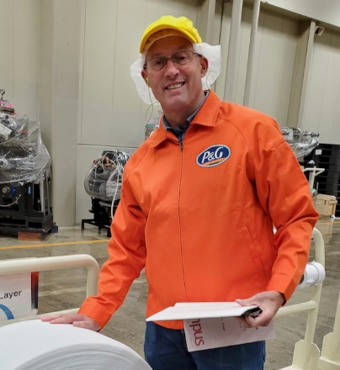


Workshop Leader Background: J.D. Landgrebe
34 years as Procter and Gamble R&D technologist
Material supply, consumer understanding, IP, R&D
Global Modeling Community
Training and mentoring
Chemical Engineering BS and MS
Aerosol Science Research and Publications – Particle Size Growth Modeling
Data science and technical modeling
Excel/VBA, JMP and Python software
Visualization, and design of experiments
PowerBI/DAX
Consulting Practice: datadelveengineer.com
LinkedIn www.linkedin.com/in/jdlandgrebe

Slide 3
Motivations/Insights– Do these Resonate?
Good collaboration on models depends on contributors having space within which to work and confidence in how to connect their work with others’
The right amount of code planning cuts down on rework and allows you to work with more complex topics
Picking a model back up from someone else (or from the one-year-ago you) can be challenging
Most models don’t have an inspectable validation trail that that builds confidence in them as you work with them and seek to extend them

Slide 4

Characteristics of Good Models and Analysis Pipelines
Good models and analyses are curated. Another knowledgeable human can look at the files and not only repeat the analysis but extend it without the author being present.
Good models and analyses are validated. They come with test cases consisting of mocked up data proving correctness of calculations, data cleaning steps and output generation. Ideally, the validation is automated to be re-run as changes are made
Good models are maintainable and extensible. They are written in a modular way, so that they are easy to build on and easy to reapply.

Slide 5

Takeaways For You From these Workshops
Grow in your ability to architect your projects for personal efficiency and collaboration
Learn to distinguish Python code by a 3-level architecture quality scale
Practice creating Level 2 (aka Jupyter notebook arranging functions into ”procedures”) code for models
Learn basic elements of a Level 3 approach
Jupyter “dashboard” + *.py code structure
”Tuhdoop” combination of pre-written Pytest validation (TDD) and object-oriented programming with Python classes (OOP)
Learn folder structures and projfiles.py file management library helpful for curating and collaboration
Model connects naturally to needed data and *.py libraries
Toggle freely between test and “production” modes to encourage validation
Version control and ability to “use” a model while continuing to develop
Gain a planning template you can use to get organized

Slide 6
Nomenclature - Practical Definitions
Curating code and projects
Others and the future you can instantly know how a model works and how to dig deeper to get more info
The “new hire” test
Benchmark: no meeting needed with model owner/developer to get going with using and extending a model
Object-Oriented Programming (Wikipedia)
Self-contained Python class for each topic
Classes can be divided and worked on in separate files (and work divided among multiple collaborators)
Class __init__ function instances the class and documents the attributes (aka variables) for the work
Single-action class functions (aka “methods”) do the work
Jupyter procedural cells or class @property functions instance the classes and call functions to do the model’s work
Test-Driven Development (Wikipedia)
Use Pytest and test datasets to validate your code (coding consists of creating parallel test_xxx.py and xxx.py files)
Pre-write the test; Write simplest version of function that passes; Refactor to improve the code

Slide 7
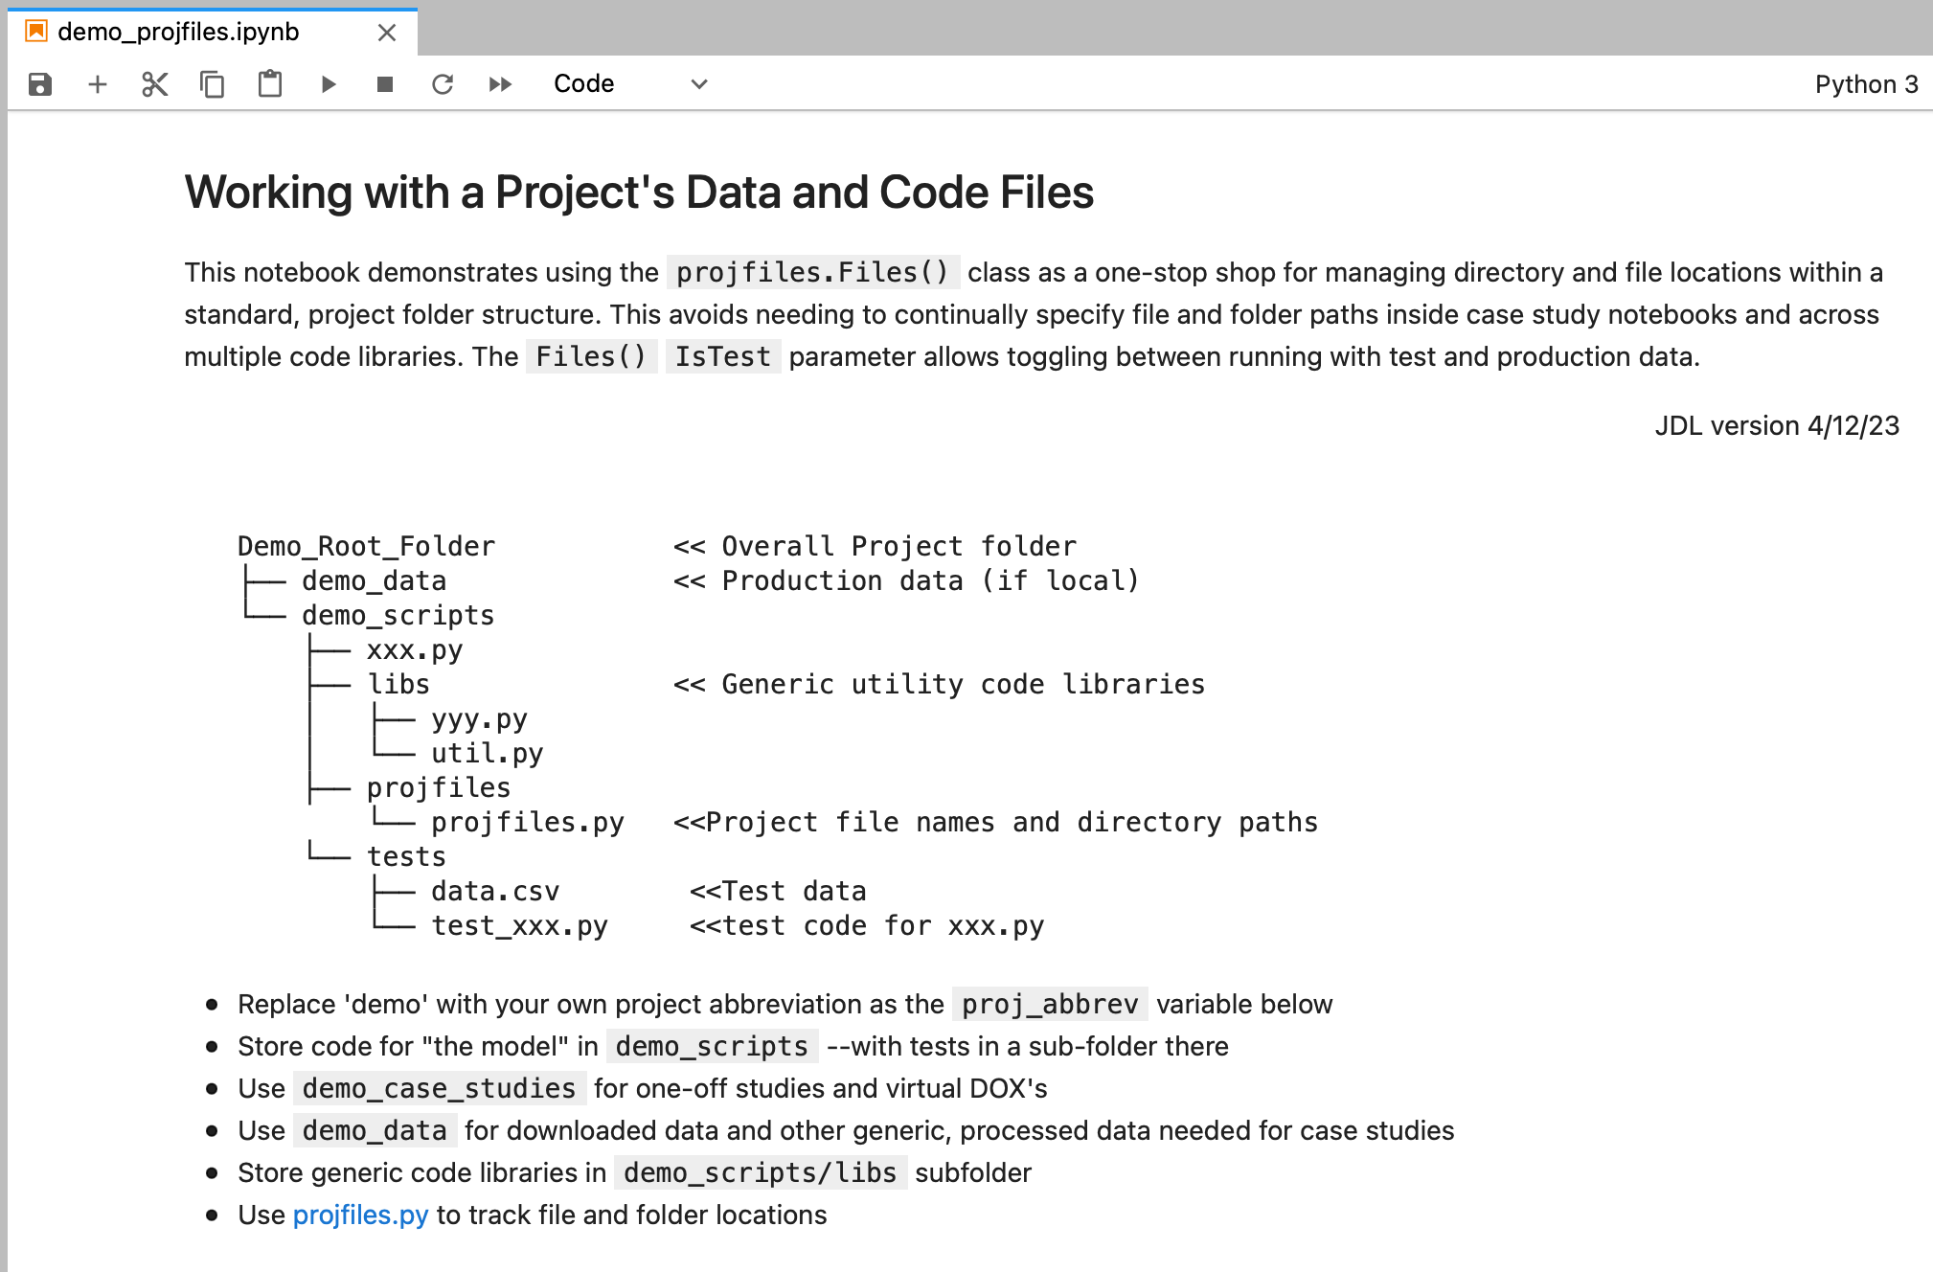
Keeping Track of A Project’s Files and Code
Open Jupyter Notebook Demo_Root_Folder/demo_analysis/_Dev_ThisProject/demo_projfiles.ipynb
The folder structure shows how to set things up for the model to be developed in a central place (demo_scripts)
_Dev_ThisProject folder represents the developer’s latest version. It has a Jupyter notebook as “dashboard” UI for running the model
Users can copy (and rename!) the _Dev_ThisProject folder and have instant access to latest version and connection to all data and scripts

Slide 8
Coding Architectures - Demos with proprietary client data
“Rambling Jupyter Scroll”
We all use them; Good for short, one-time analyses
Usefulness breaks down as complexity increases
Tough to develop in collaboration with others
Difficult to validate/test without immense clutter
Single-action Functions/”Procedures” that sequentially call functions
Functions are individually testable
Easy to develop and to view in-progress results
Difficult to systematically test especially in Jupyter notebooks
Object-oriented/Classes
Uses alternate ”self” syntax that takes getting used to
The open-source/developer savvy way to do it
Easy to access all attributes to debug and test
Fits naturally with validation by separate Pytest “tests” file

Slide 9
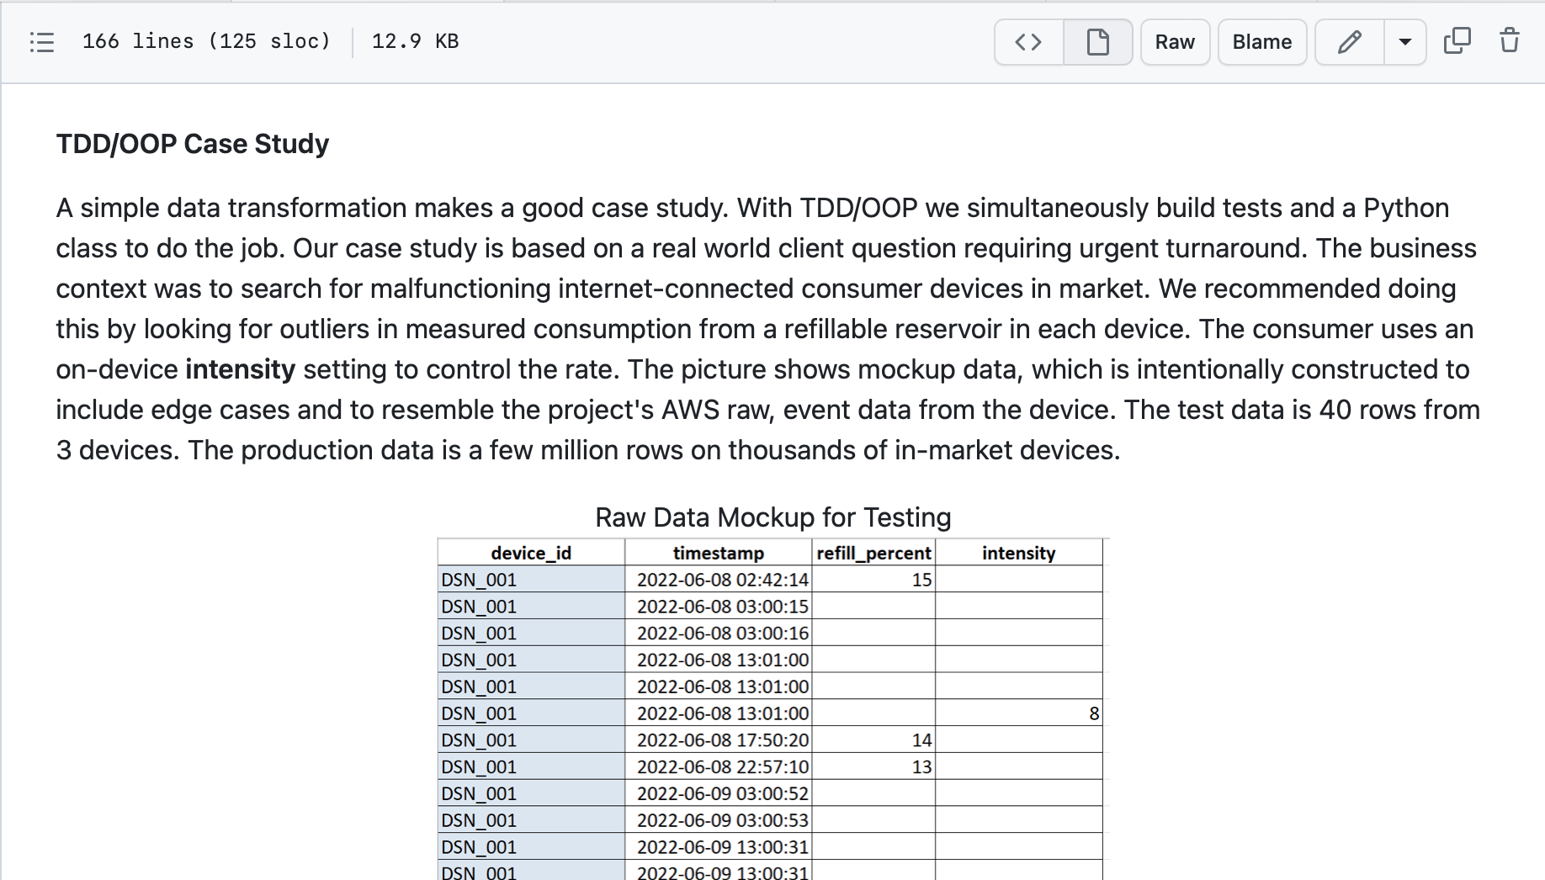
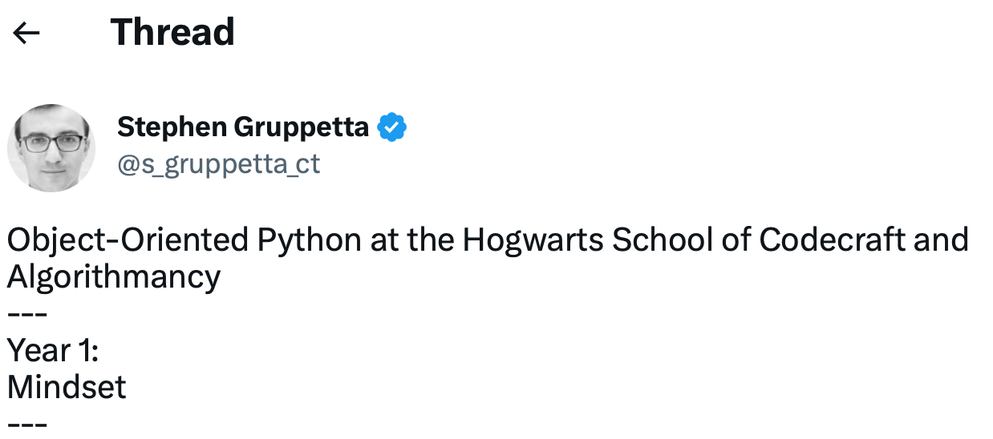
Getting Started with Python Classes And Testing
Homework for next time:
Download repository and review tutorial.md from TDD_OOP_Tutorial Github repo
Great Twitter thread by Stephen Gruppetta teaching Object-Oriented Programming.
Entitled, “Object-Oriented Python at the Hogwarts School of Codecraft and Algorithmancy” (he picked a theme and stuck with it…)
See his “Years” 1, 2 and 3 threads (4 through 7 are great but mostly beyond scope of what we will need and cover in next session)
Year 1
Year 2
Year 3

Slide 10
Coding “Styles” aka Architecture
Level 1 – ad hoc “random walk” Jupyter notebook
Fast
Not well curated
Hard to validate with re-runnable checks
Hard to maintain/extend
Level 2 – Procedure/function hierarchies Jupyter
Better curation and extensibility
Better for Validation but still difficult
Level 3 – TDD/OOP aka Tuhdoop
Ideal for models that will be re-used
Re-runnable Pytest testing
Use Jupyter notebook as UI only; put code in *.py file

Slide 11
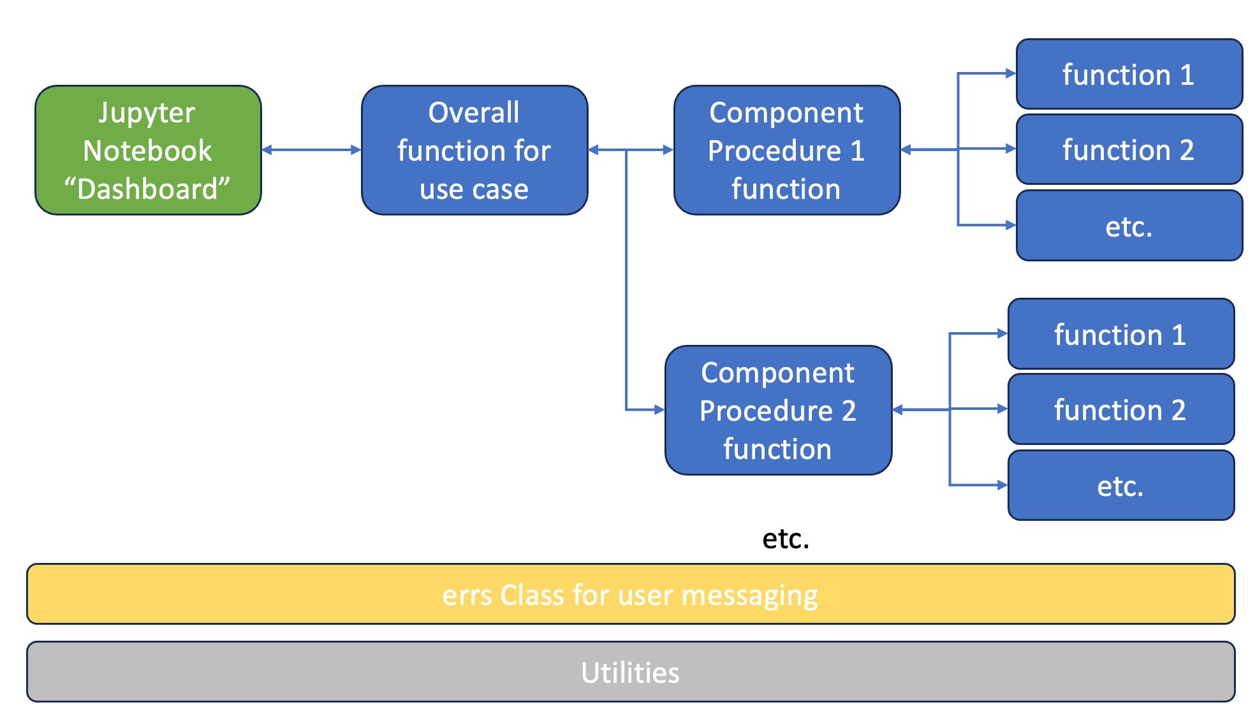
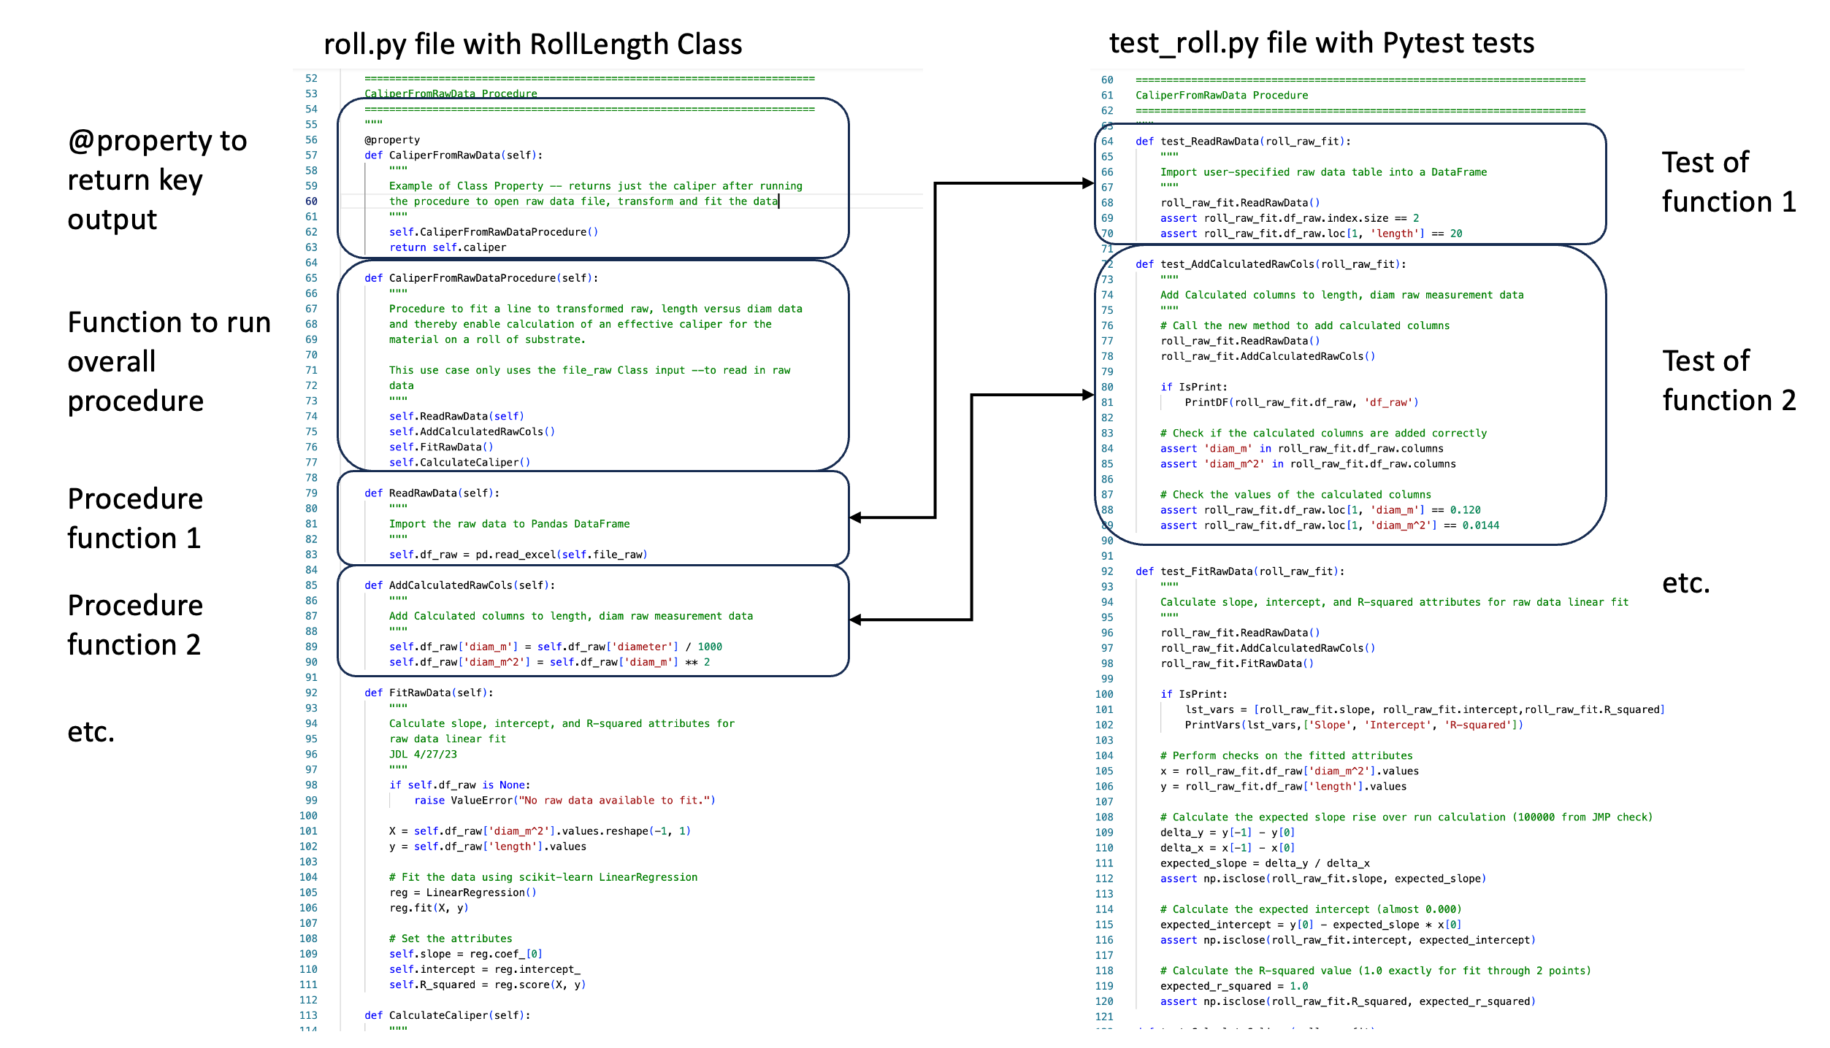
Level 3 Code Arrangement

Slide 12
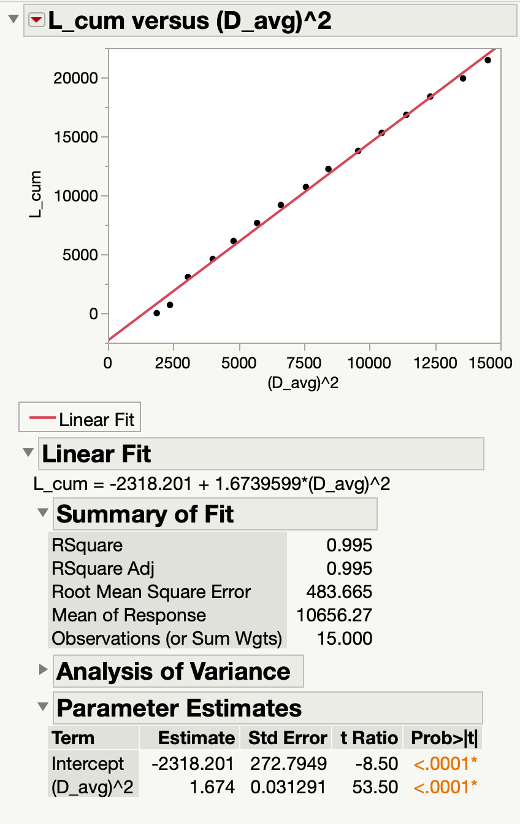
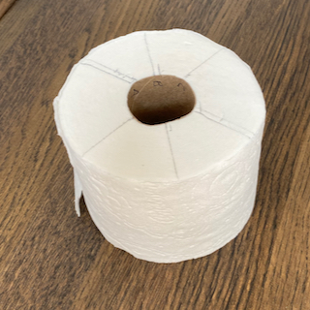
Example Model for Learning ”TuhDooP”
Model is a teaching case study in Digital Transformation with Excel Online Course
We can use its raw and transformed data for validating a Python version
Roll Length Model.xlsx - Toilet paper example
Technical model to calculate length of substrate on a roll based on diameter
Model is industrially useful in R&D and manufacturing settings
Example raw data and equation derivation available as background in file
Transformed/Linearized

